Slide 1
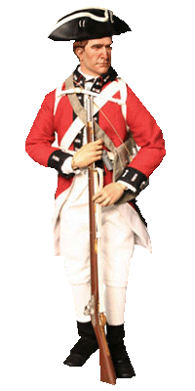
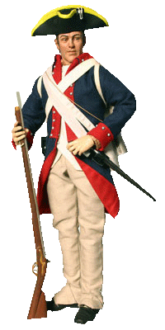
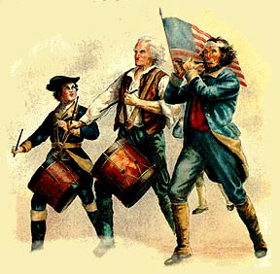
Battles
of the
American Revolutionary
War

Slide 2
Battle of
Lexington & Concord
Lexington & Concord were in Massachusetts
Minutemen were ready to fight at a moments notice
Samuel Adams & John Hancock were two Sons of Liberty that met in Lexington.
General Gage was the General that led the British.
General Gage sent over 700 soldiers to Lexington & Concord to arrest these two leaders.
Paul Revere rode ahead to warn them of this plan.

Slide 3
Battle of
Lexington & Concord
John Parker, a minuteman leader, shouted:
“Don’t fire unless fired upon, but if they mean to
have war, let it begin here.”
Eight minutemen were killed and seven others were wounded.
The first shot that was heard in Lexington was known as “The shot heard around the world”

Slide 4
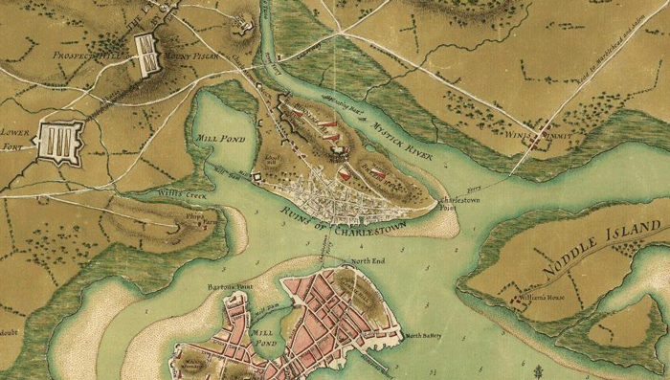
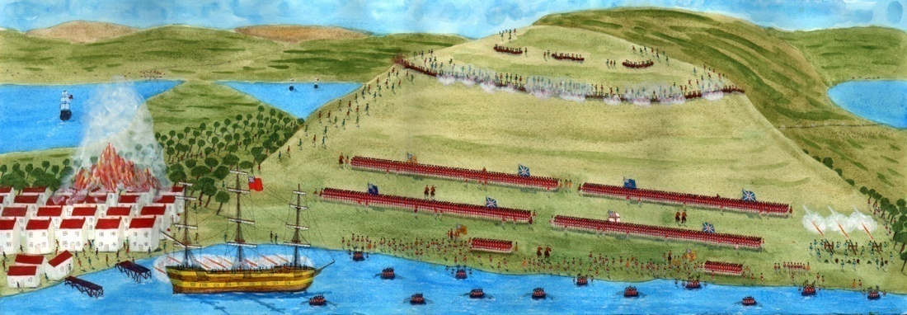
Battle of
Bunker Hill

Slide 5
Battle of
Bunker Hill
June 17th, 1775 and located in Massachusetts
Israel Putnam & William Prescott arrive at Breed’s Hill
Instructed soldiers to build walls made with earth and stone called earthworks to help them defend themselves
Breed’s Hill was captured by British with the aid of General William Howe and 2,400 soldiers
Putnam shouted “Don’t fire until you see the whites of their eyes” to save bullets

Slide 6
Battle of
Bunker Hill
Charlestown set on fire by cannon fire from British ships
British won the battle while suffering heavy losses
Breed’s Hill was wrongly named Bunker Hill
Olive Branch Petition sent to King George III and asked for peace
An olive branch is the symbol for peace
The petition did little good due to time it took to get to England

Slide 7
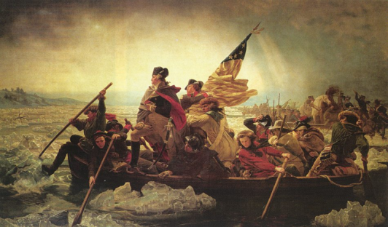
Battle of
Trenton
Location – Trenton, New Jersey - December 1776
George Washington now in charge of Continental Army
Most of the army were farmers that signed up to fight, or had just enlisted
The British army used hired soldiers, or mercenaries that came from a German region.
George Washington leads troops across Delaware River and attacked Hessain troops (mercenaries) until they surrendered

Slide 8
Battle of
Saratoga
Location – Saratoga, New York September 1777
The British had put in place a series of military actions that would be carried out with a goal was also known as a campaign. They tried to cut off communications.
1st battle lost - Gen. Burgoyne could not break through American lines – surrendered to Gen. Horatio Gates
2nd battle lost – Gen. Burgoyne surrendered to Gen. Benedict Arnold – this was an event that caused an important change, also known as a turning point.

Slide 9
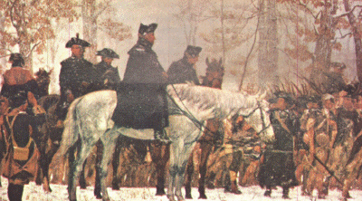
Valley Forge
Location – Valley Forge, Pennsylvania – Fall 1777
Times were tough for the soldiers with lack of supplies
Yankee Doodle was sung to keep spirits up
Marquis de Lafayette from France joined the Continental army to help
Friedrich Wilhelm Von Steuben taught the troops better ways to march and fight

Slide 10
Valley Forge
By 1778 the American army was stronger
Benjamin Franklin was in France trying to reach an agreement or negotiate with the French government
French agreed to help after news of Saratoga victory
Bernardo de Galvez, governor of Spanish Louisiana gave supplies to the American troops
The Netherlands gave a loan, Russian leaders helped with American trading blockades

Slide 11
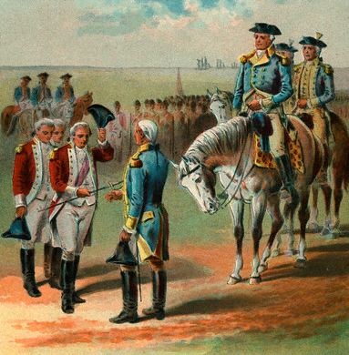
Battle of
Yorktown
Location – Yorktown, Virginia– Summer 1781
British Gen. Charles Cornwallis setup camp in Yorktown on the Chesapeake Bay.
French and American troops surrounded Cornwallis on both land and sea
Cornwallis surrendered after weeks of being surrounded

Slide 12
Battle of
Yorktown
location – Paris France – The Treaty of Paris
John Jay, Benjamin Franklin, and John Adams were the American negotiators
British agreed to all terms after one year
Treaty of Paris signed on September 3, 1783
The war was over

