Slide 1
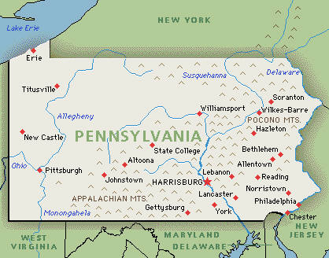
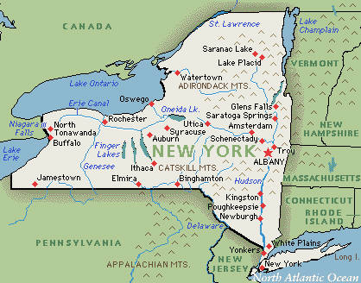
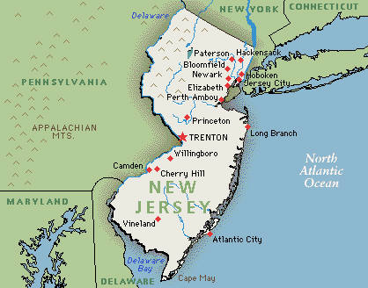
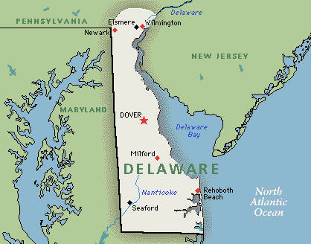
Middle Colonies
CAMDEN

Slide 2

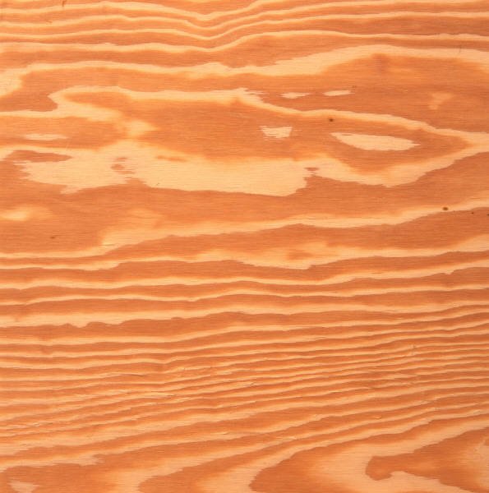
Resources
Natural Resources
Forest
Rivers
Atlantic ocean
Harbors
Soil
Lumber
Fish, Navigation
Whaling
Ship building
Farms

Slide 3
Settling
Land rich and fertile
Climate more inviting than New England
Religious freedom
Business opportunity for small shop owners

Slide 4
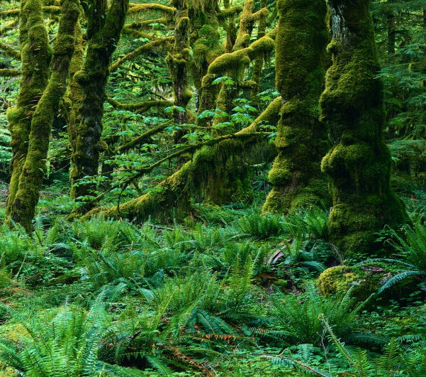
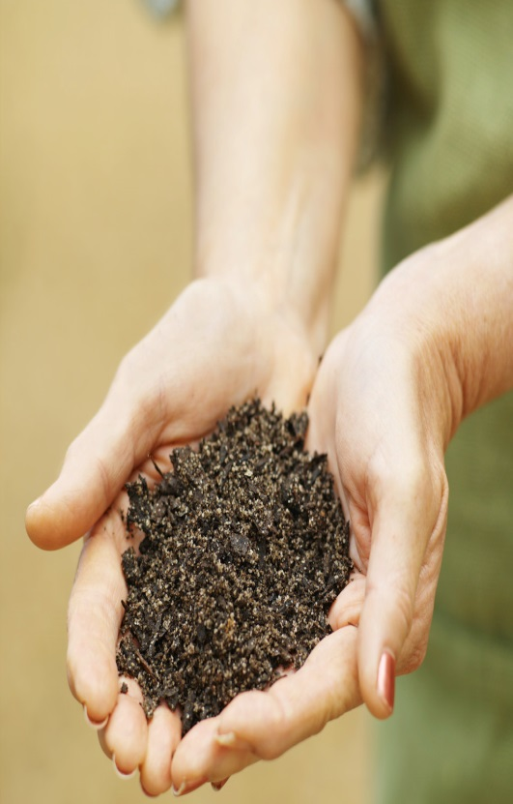
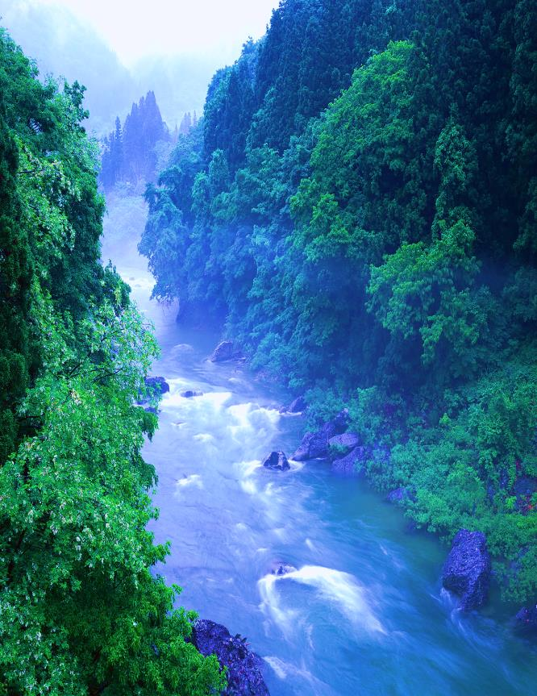
Crops
Middle colonist made the name the breadbasket colony on the food supplies. They had very fertile soil. They also had moderate climate.
All of the jobs listed are things made by from their land. They got lots of things from the land, Atlantic ocean, and forest.

Slide 5
Economy / Jobs
Blacksmith
Farmers
Cooper
Fisherman
Seamstress
Artisan
Silversmith
Tailors
Fur trapping
Soap makers
Ship builders
Grist miller
Common jobs for the middle colonies were farmers, ship builders, and whalers.
For food supplies they had corn, rye, barley, and oats. That it how they called it the breadbasket colony.

Slide 6
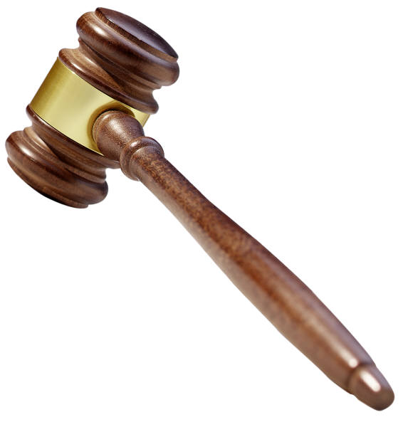
Government
Camden
Town meetings
White landowning man can vote
Framers(Pennsylvania)
House of Burgesses
Middle colonist’s reason for settlement is to escape war, freedom and practice religion.
They thought they good live freely in Pennsylvania.

