Slide 1
Subjects & Predicates
Project LA Activity

Slide 2
Every complete sentence contains two parts: a subject and a predicate.
The subject is what (or whom) the sentence is about, while the predicate tells something about the subject.

Slide 3
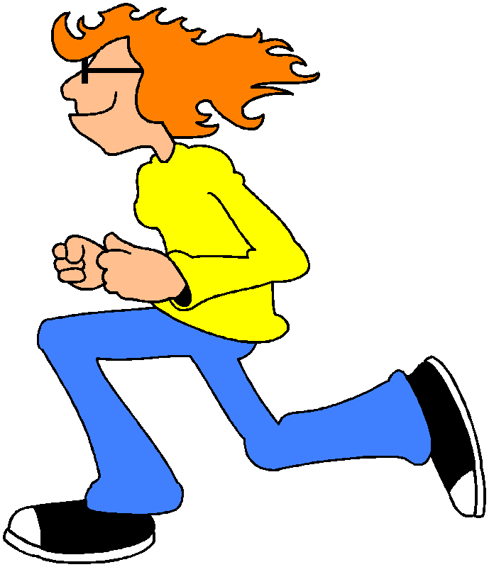
Judy and her dog run on the beach every morning.

Slide 4
Judy and her dog run on the beach every morning.
First find the verb and then make a question by placing ``who?'' or ``what?'' before it.
The answer is the subject, Judy and her dog.

Slide 5
Let’s try one:
We spilled popcorn on the floor.
What is the verb of this sentence?
We spilled popcorn on the floor.

Slide 6
Now find the subject:
We spilled popcorn on the floor.
Now decide who or what spilled popcorn?
We spilled popcorn on the floor.

Slide 7
Can you find the subject in each sentence below?
My little brother broke his finger.
His Uncle Bob asked for directions.
Those students carried books.
Our babysitter arrived late.

Slide 8
Can you find the subject in each sentence below?
My little brother broke his finger.
His Uncle Bob asked for directions.
Those students carried books.
Our babysitter arrived late.

Slide 9
Can you find the predicate in each sentence below?
My little brother broke his finger.
His Uncle Bob asked for directions.
Those students carried books.
Our babysitter arrived late.

Slide 10
Can you find the predicate in each sentence below?
My little brother broke his finger.
His Uncle Bob asked for directions.
Those students carried books.
Our babysitter arrived late.

Slide 11
Simple Subject and Simple Predicate
Every subject is built around one noun or pronoun (or more). When all other words are removed the simple subject is left.

Slide 12
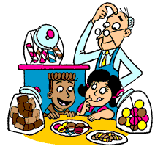
Simple Subject
A piece of chocolate candy would taste great.
The main word in the subject is the noun ``piece,'' with the other words of the subject -- ``a'' and ``of pepperoni pizza'' – tell about the noun. ``piece'' is the simple subject.

Slide 13
Can you find the simple subject in each sentence below?
My little brother broke his finger.
His Uncle Bob asked for directions.
Those students carried books.
Our babysitter arrived late.

Slide 14
Can you find the simple subject in each sentence below?
My little brother broke his finger.
His Uncle Bob asked for directions.
Those students carried books.
Our babysitter arrived late.

Slide 15
Simple Predicate
A simple predicate is always the verb or verbs that links up with the subject.

Slide 16
Simple Predicate
A piece of chocolate candy would taste great.
The simple predicate is ``would taste'' -- in other words,
the verb of the sentence.

Slide 17
Can you find the simple predicate in each sentence below?
My little brother broke his finger.
His Uncle Bob asked for directions.
Those students carried books.
Our babysitter arrived late.

Slide 18
Can you find the simple predicate in each sentence below?
My little brother broke his finger.
His Uncle Bob asked for directions.
Those students carried books.
Our babysitter arrived late.

Slide 19
Compound Subject
A sentence may have a compound subject -- a simple subject made up of more than one noun or pronoun.
ACDC
No Doubt

Slide 20
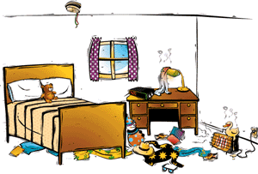
Can you find the compound subjects?
Team pennants, rock posters and family photographs covered the boy's bedroom walls.

Slide 21
Can you find the compound subjects?
Team pennants, rock posters and family photographs covered the boy's bedroom walls.

Slide 22
Can you find the compound subjects?
Her uncle and she walked slowly through the art gallery and admired the beautiful pictures exhibited there.

Slide 23
Can you find the compound subjects?
Her uncle and she walked slowly through the art gallery and admired the beautiful pictures exhibited there.

Slide 24
Can you find the compound subject in each sentence below?
My little brother and my cousin broke their fingers.
His Uncle Bob and Aunt Betty asked for directions.
Those students and teachers carried books.
Our babysitter and her friend arrived late.

Slide 25
Can you find the compound subject in each sentence below?
My little brother and my cousin broke their fingers.
His Uncle Bob and Aunt Betty asked for directions.
Those students and teachers carried books.
Our babysitter and her friend arrived late.

Slide 26
Compound Predicate
A compound predicate, is more than one verb relating to the same subject.

Slide 27
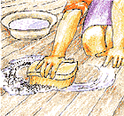
Can you find the compound predicate?
Mother mopped and scrubbed the kitchen floor.

Slide 28
Can you find the compound predicate?
Mother mopped and scrubbed the kitchen floor.

Slide 29
Can you find the compound predicate in each sentence below?
My little brother bruised and broke his finger.
His Uncle Bob looked and asked for directions.
Those students carried and used books.
Our babysitter overslept and arrived late.

Slide 30
Can you find the compound predicate in each sentence below?
My little brother bruised and broke his finger.
His Uncle Bob looked and asked for directions.
Those students carried and used books.
Our babysitter overslept and arrived late.

Slide 31
Now that you know all about subjects and predicates, try the subject and predicate song and sing along!
MAIN

